Slide 1
Part1. 데이터 분석 흐름 이해 및 시계열 데이터 분석 준비하기
1회차: 분석 싸이클 이해 및 수학/통계/Python 언어 이해하기
2회차: 시계열 데이터 접근방법 리뷰 및 “분석초안” 실습 완성
2019.03.02.
김경원(cheonbi@snu.ac.kr)

Slide 2
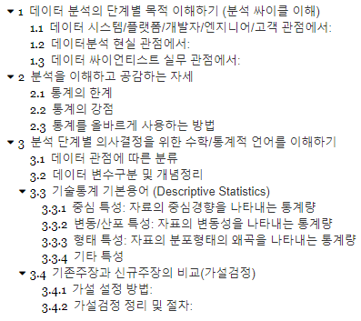
강의순서(Part1: 1회차)

Slide 3
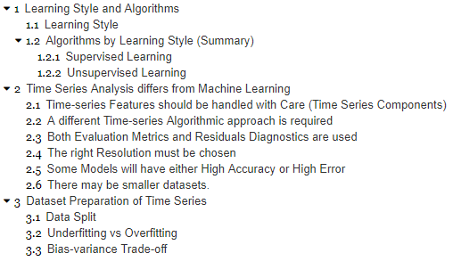
강의순서(Part1: 2회차)

Slide 4
Part1: 1회차 강의의 목적.
“분석 싸이클 이해
및 수학/통계/Python 언어 이해하기”

Slide 5
Part1: 2회차 강의의 목적.
“시계열 데이터 접근방법 리뷰
및 “분석초안” 실습 완성”

Slide 6
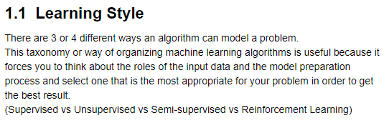
1. Learning Style and Algorithms

Slide 7
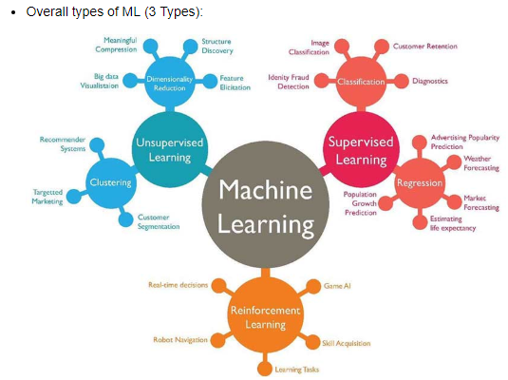
1. Learning Style and Algorithms

Slide 8
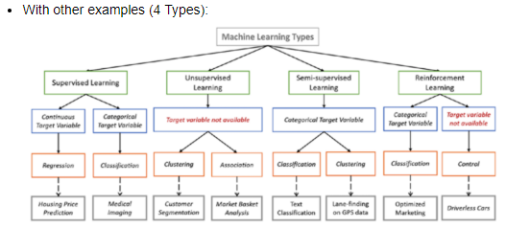
1. Learning Style and Algorithms

Slide 9
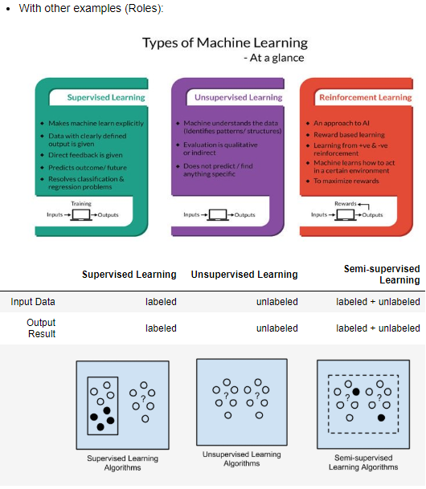
1. Learning Style and Algorithms

Slide 10
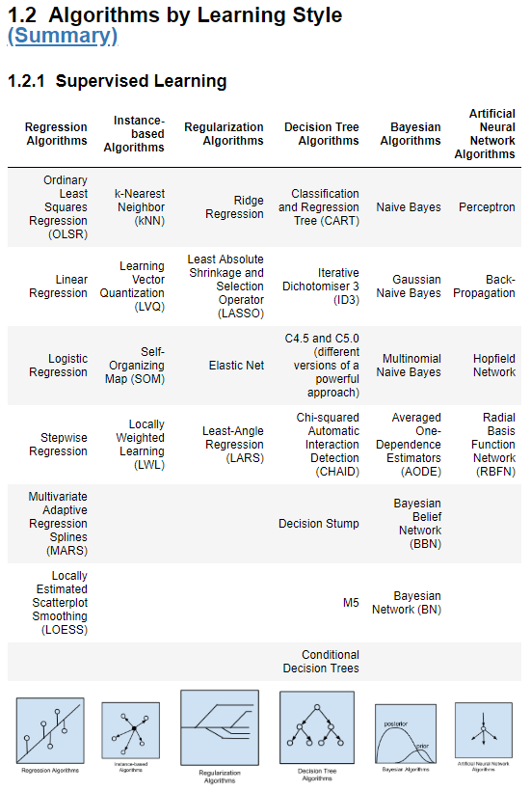
1. Learning Style and Algorithms

Slide 11
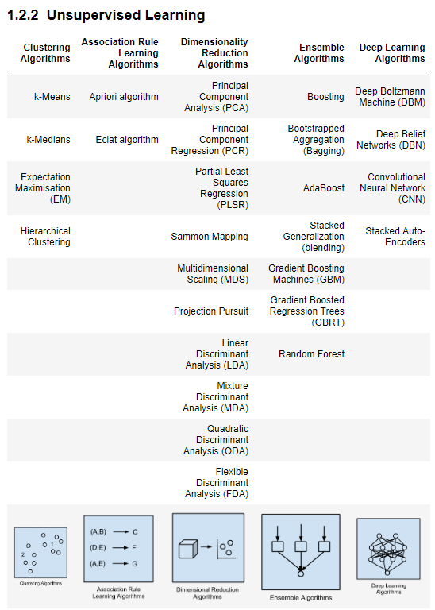
1. Learning Style and Algorithms

Slide 12
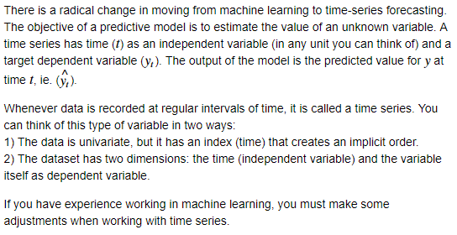
2. Time Series Analysis differs from Machine Learning

Slide 13
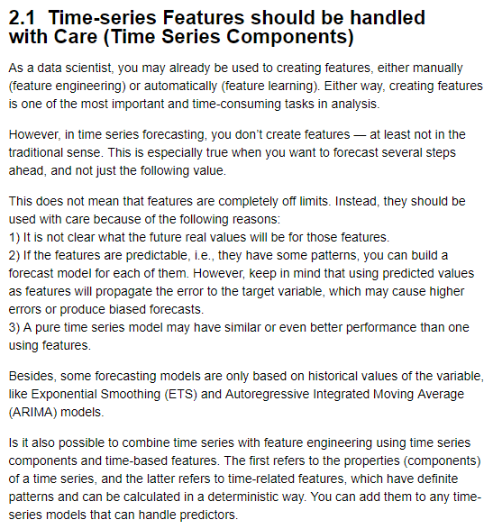
2. Time Series Analysis differs from Machine Learning

Slide 14
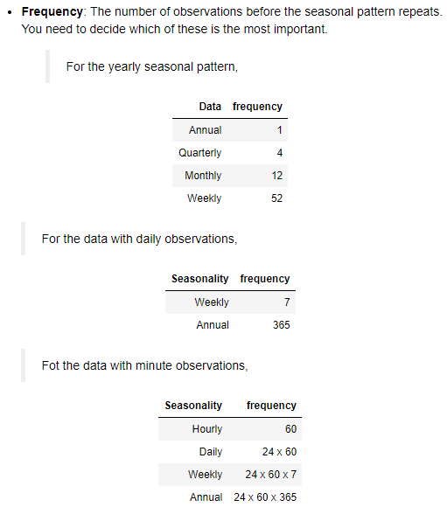
2. Time Series Analysis differs from Machine Learning

Slide 15
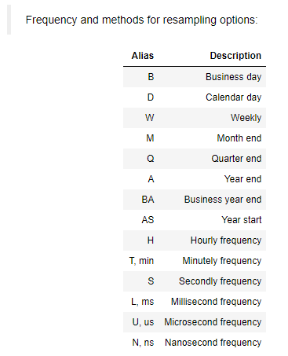
2. Time Series Analysis differs from Machine Learning

Slide 16
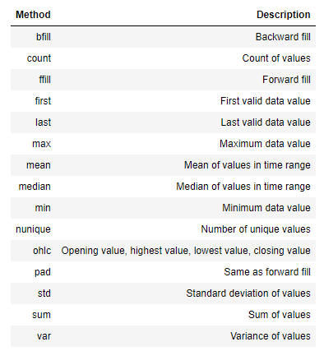
2. Time Series Analysis differs from Machine Learning

Slide 17
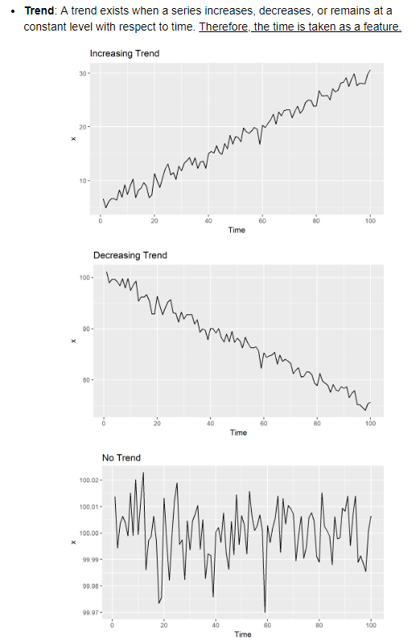
2. Time Series Analysis differs from Machine Learning

Slide 18
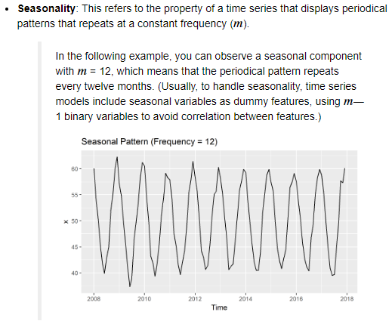
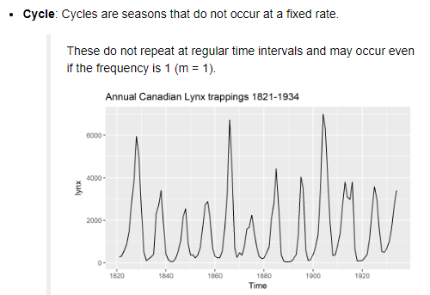
2. Time Series Analysis differs from Machine Learning

Slide 19
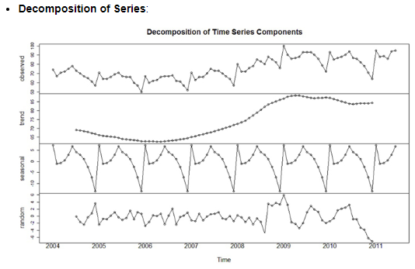
2. Time Series Analysis differs from Machine Learning

Slide 20
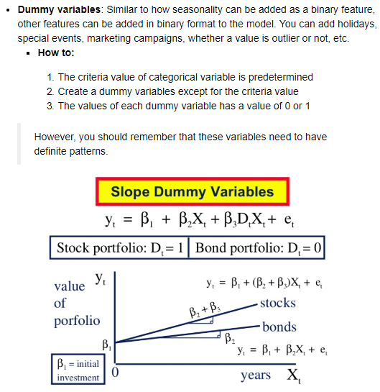
2. Time Series Analysis differs from Machine Learning

Slide 21
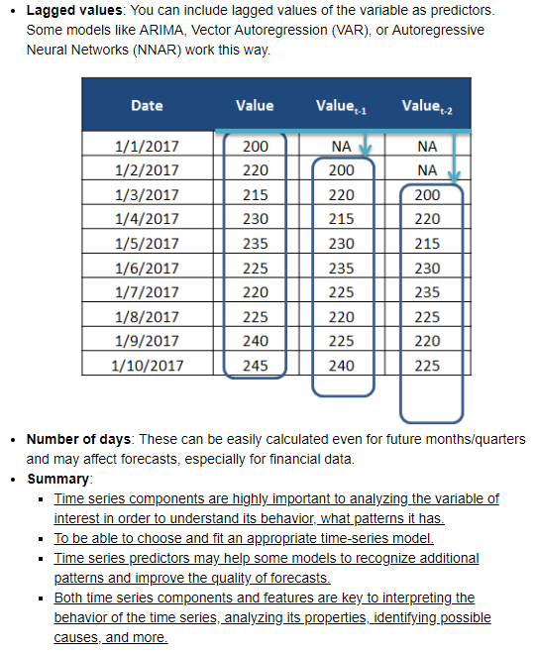
2. Time Series Analysis differs from Machine Learning

Slide 22
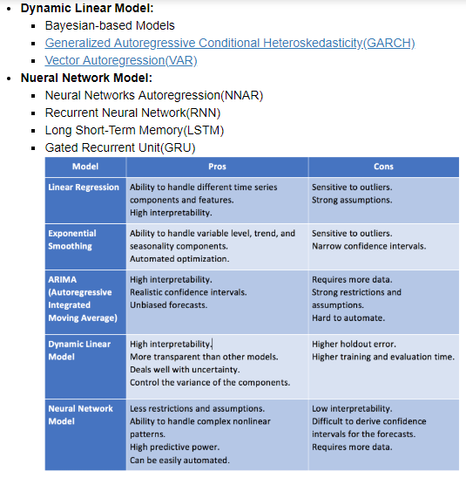
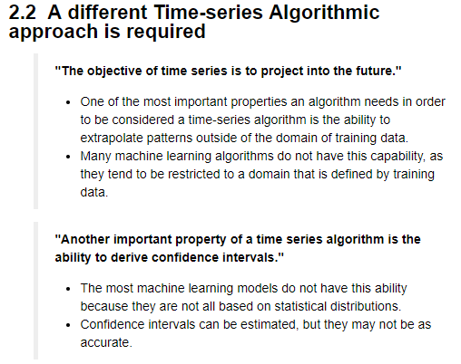
2. Time Series Analysis differs from Machine Learning

Slide 23
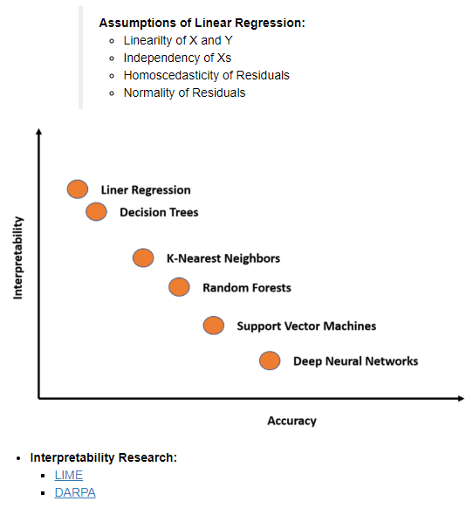
2. Time Series Analysis differs from Machine Learning

Slide 24
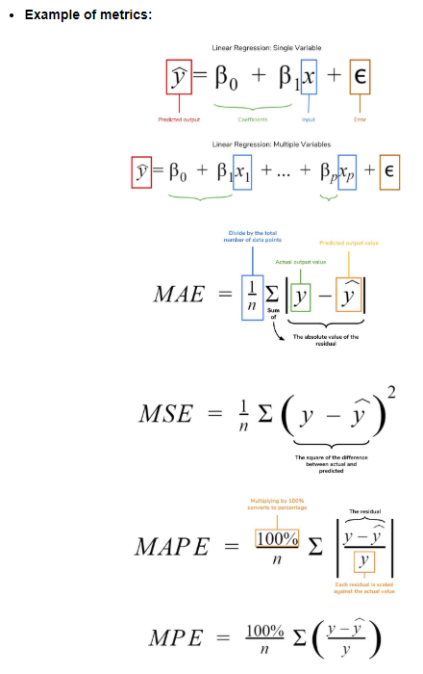
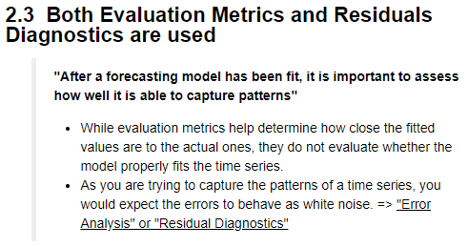
2. Time Series Analysis differs from Machine Learning

Slide 25
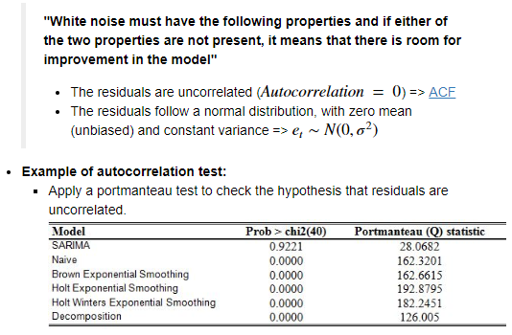
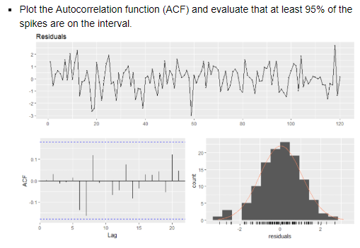
2. Time Series Analysis differs from Machine Learning

Slide 26
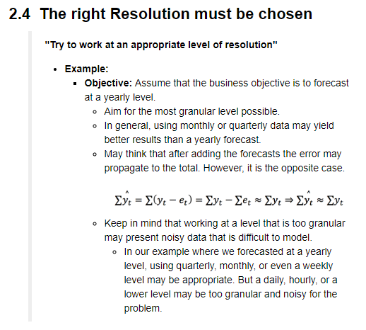
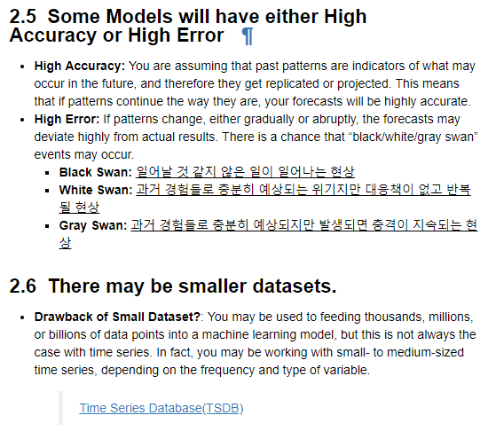
2. Time Series Analysis differs from Machine Learning

Slide 27
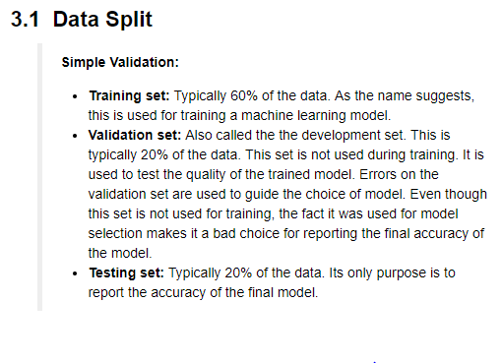
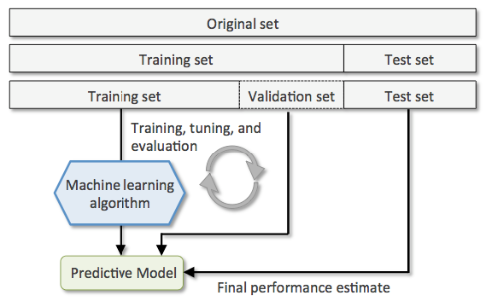
3. Dataset Preparation of Time Series

Slide 28
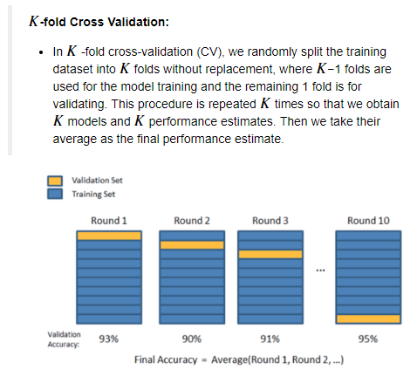
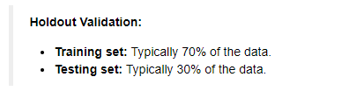
3. Dataset Preparation of Time Series

Slide 29
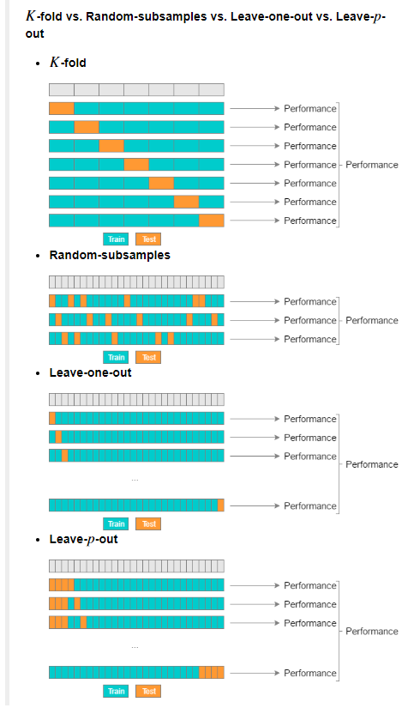
3. Dataset Preparation of Time Series

Slide 30
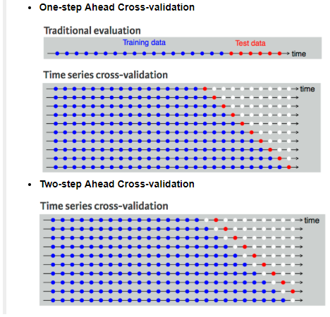
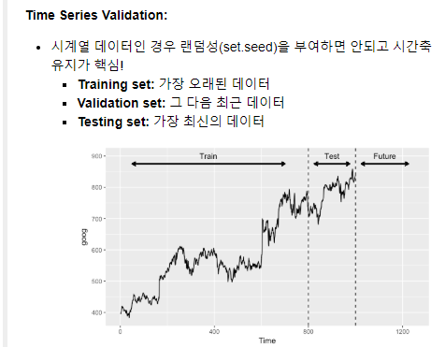
3. Dataset Preparation of Time Series

Slide 31
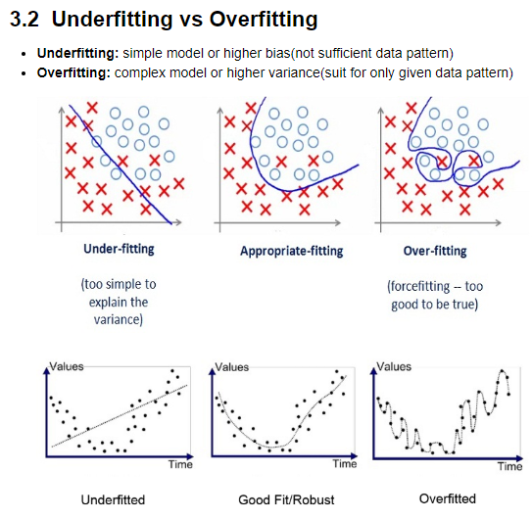
3. Dataset Preparation of Time Series

Slide 32
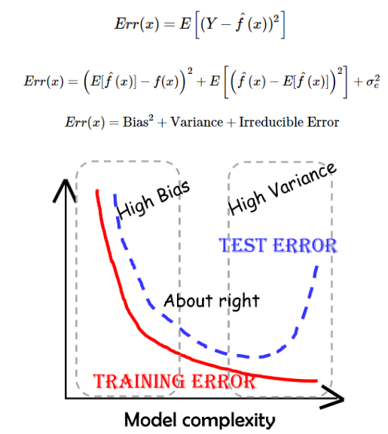
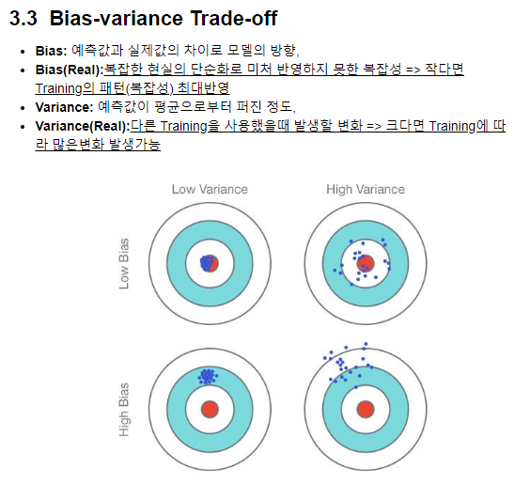
3. Dataset Preparation of Time Series

Slide 33
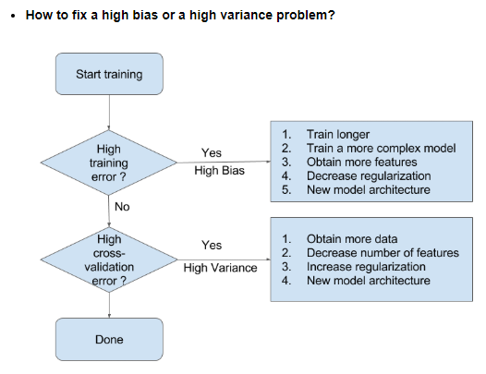
3. Dataset Preparation of Time Series

Slide 34

감사합니다.

